Slide 1

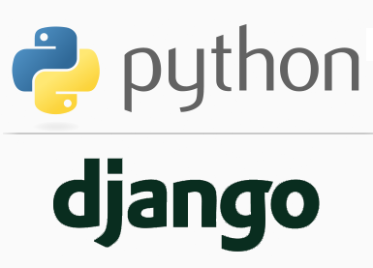
FULL STACK WEB DEVELOPMENT WITH DJANGO
Lecture 6

Slide 2

Today’s Agenda
Developing Our Django App
What Is An App ?
Creating An App
Default Components Of An App
Activating The App
Understanding A View
Creating A View
Configuring The URL
Running The App

Slide 3
What Is An App ?
As previously discussed , an app in Django is created to perform a particular functionality for our entire web application (Django Project)
For example we could have a Django Project(website, webapplication) called voting which could contain a registration app, a polling app, comments app, etc.
Thus every Django Project is a collection of one or more Django Apps.

Slide 4
Steps Required For Creating And Running An App
To create and run a Django app , we need to follow 6 steps assuming that we have already created the Django project which will contain this app:
Creating the app
Activating the app
Creating the View
Configuring the View in Url
Running the server
Opening the page in browser

Slide 5
Creating An App
To create an app we use the following command:
django-admin startapp appname
where appname is the name of our Django app
For example:
django-admin startapp greetingsapp
The above command has to be executed from the directory which contains the file manage.py
When we execute the above command Django will create appropriate file/folder structure for our app

Slide 6
Step 1: Creating An App
Launch VS Code and open the folder called myvsdjangoproject that we created previously.
Activate the Virtual Environment by selecting View→Command Palette→Select Python Interpreter→Python 3.7.0(vsdjango:virtualenv)
Open the terminal by selecting Terminal: New Terminal
Go to the project directory called demoproject by using the cd command and now ,type the following command:
django-admin startapp greetingsapp

Slide 7
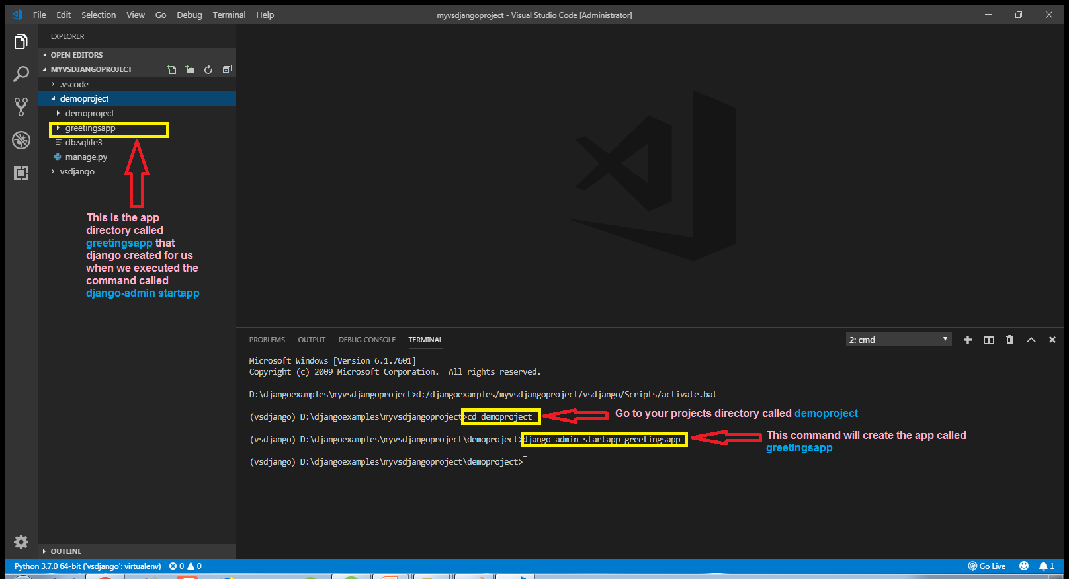
Step 1: Creating An App

Slide 8
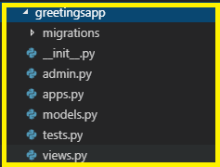
Default Components Of A Django App
Whenever we create a Django App with the command:
django-admin startapp appname
Then Django creates a particular folder/file structure which is almost same as the folder/file structure of Django project but with some new components

Slide 9
Default Components Of A Django App
Let us discuss each of them to have a better understanding:
migrations folder
This directory stores all the database migrations of our app. It is initially empty because there are no migrations present by default.
__init__.py file
A package in Python is a collection of modules and can be imported in same way like a module.
This file is an empty file and it tells Python that this directory has to be treated as a Python package

Slide 10
Default Components Of A Django App
admin.py file
This file is the configuration file for the built in admin app provided by Django. It contains all the models we need for administration app which can be used for maintaining and customizing site data.
apps.py file
This file contains application level configuration.
It contains information about classes used in our apps and other metadata.

Slide 11
Default Components Of A Django App
models.py file
This file contains all the models used by our application .
Recall that models are classes that represent database tables.
So all the tables used by our app will be represented as models in this file, with their columns declared as data members in these classes.
tests.py file
This file contains all the test functions used for testing our application’s code

Slide 12
Default Components Of A Django App
views.py file
This file is the most important file.
This is where we have functions that handle requests and return responses.
All the application logic goes here , for example, when the user clicks a button what needs to be done is coded here.

Slide 13
Step 2: Activating The App
Once we have created an app we must let Django know about it so that Django can keep track of our application and allow us to do sttuff with the app like create database tables etc.
To do this we must make an entry of our app in the INSTALLED_APPS list of the settings.py file of the default app given by Django.

Slide 14
Step 2: Activating The App
Open the settings.py file in the demoproject app of our demoproject folder and make the entry shown in green color in the INSTALLED_APPS list
Code:
INSTALLED_APPS = [
'django.contrib.admin',
'django.contrib.auth',
'django.contrib.contenttypes',
'django.contrib.sessions',
'django.contrib.messages',
'django.contrib.staticfiles',
'greetingsapp',
]
Why we are puttng an extra comma here ?
This is just a convention we use in Python and it’s useful for consistency across multiple lines

Slide 15
Understanding Views
Before creating our first webpage, let us discuss what is a view ?
A view or view function in Django is simply a Python function/method that takes a web request and generates a web response.

Slide 16
Understanding Views
A view fetches data from our database (or an external data source or service) and delivers it to a template or directly to the browser.
The view makes decisions on what data gets delivered ,either by acting on input from the user, or in response to other business logic and internal processes.

Slide 17
Understanding Views
In the early days of Django, there were only function-based views, however, as Django has grown over the years, Django’s developers added class-based views.

Slide 18
Step 3:Creating Our First View
To create our first view, we need to modify the views.py file in our greetingsapp app
Open the views.py file and write the code shown in the next slide

Slide 19
Step 3:Creating Our First View
from django.shortcuts import render
from django.http import HttpResponse
def welcomePage(request):
return HttpResponse("<h1>Welcome To Sharma Computer Academy!</h1>")

Slide 20
Code Explained
from django.shortcuts import render
This line imports the render() method and is added to the file automatically by the startapp command .
The method render() is used when rendering templates.
from django.http import HttpResponse
Each view that we write is responsible for instantiating, populating, and returning an HttpResponse.
The HttpResponse class lives in the django.http module.

Slide 21
Code Explained
def welcomePage(request):
return HttpResponse("<h1>Welcome To Sharma Computer Academy!</h1>")
The name of our view function is welcomePage( ) .
We can give it any name we like but it should accept one argument which is called request object and belongs to the class HttpRequest
Finally our view function has to return a web response which in this case is an object of the class HttpRepsonse containing plain HTML data

Slide 22
Step 4:Configuring The Url
After creating and updating the views.py as shown in the previous slide if we start the server and access the url http://127.0.0.1:8000 , then still we will get the default Django page .
In order for Django to use our new view, we need to tell Django that this is the view we want to be displayed when someone navigates to the site root (home page)

Slide 23
Step 4:Configuring The Url
We do this by in 2 ways :
Either by editing the urls.py and configuring the mapping for our view function there
OR
By creating a new urls.py file in our greetingsapp and configuring the mapping there
As of now we will use the first approach and afterwards we will go for the second option also

Slide 24
Step 4:Configuring The Url
When we configure the urls.py , we have to call a function called path()
This function comes from the django.urls module and its general syntax is:
path( route, view,[name])
The argument route should be a string with which incoming url will be matched
The second argument view , should be the name of a view function to be called for serving this url request

Slide 25
Step 4:Configuring The Url
For example : path('mypage/', views.myview)
In this example, a request to http://127.0.0.1:8000/mypage would be routed to the myview function in the application’s views.py file
The path() function also takes an optional parameter called name that we will discuss later

Slide 26
Step 4:Configuring The Url
So , we must open the file urls.py in the demoproject folder and write the following code in it.
Code (demoproject/urls.py):
from greetingsapp import views
urlpatterns = [
path('admin/', admin.site.urls),
path('welcome.html',views.welcomePage)
]

Slide 27
Code Explained
from greetingsapp import views
This line imports the views module of the greetingsapp application
This import is necessary as we want to use the function welcomePage in this urls.py file.

Slide 28
Code Explained
urlpatterns = [
path('admin/', admin.site.urls),
path('welcome.html',views.welcomePage)
]
The file urls.py already contains a list called urlpatterns
This list contains the URL patterns registered for the project.
It already contains an entry which tells Django that if a url like http://127.0.0.1:8000/admin arrives then it should be redirected to admin app..
Similarly we want that if the url http://127.0.0.1:8000/welcome.html arrives then Django should call our function welcomePage() defined in views.py of greetingsapp

Slide 29
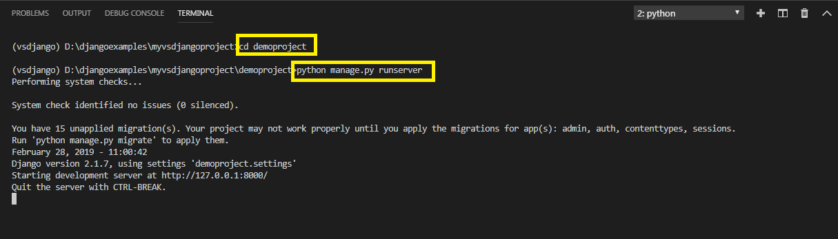
Step 5:Running The Server
To run our new greetingsapp , go to the folder demoproject by using cd command and type the runserver command in VS Code terminal
cd demoproject
python manage.py runserver.
The server runs on the default port 8000, and we’llsee output like the following output in the terminal window:

Slide 30
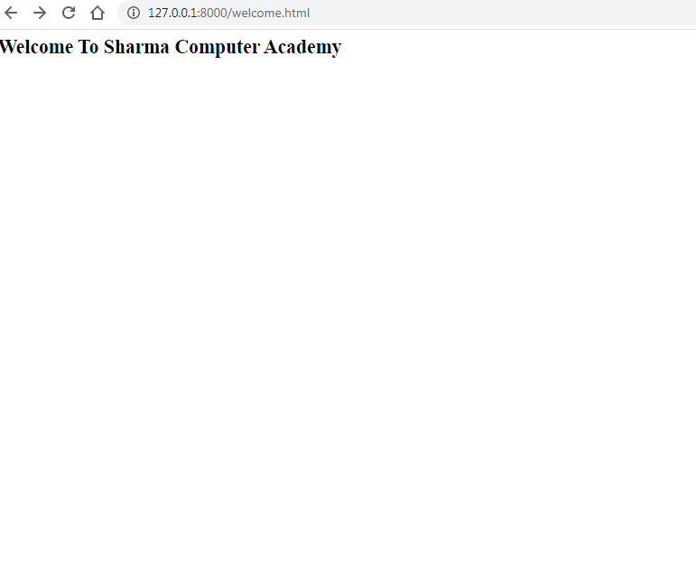
Step 6: Opening The Page
Type the http://127.0.0.1:8000/welcome.html URL in browser to navigate to
that address. Now we should see a plain, but functioning welcome page

Slide 31
So What Just Happened ?
To better understand how Django works, let’s trace the entire set of activities that took place when we requested the url http://127.0.0.1:8000/welcome.html
1. Our browser sent a message to the Django development server requesting it to return the content located at the URL (http:// 127.0.0.1: 8000/welcome.html)
2.Django then looked for a URL pattern that matches the request, by searching the site level urls.py
3. Django checks the first pattern (“admin/”) in our site level urls.py which doesn’t match, and moves on to the second line in which the string(‘welcome.html’) matches.

Slide 32
So What Just Happened ?
4. The matching pattern says “call the function welcomePage of views module in greetingsapp”.
5. Now Django sends the request is to the welcomePage() function in views.py
6. The welcomePage() function/view then renders our simple HTML message to an HttpResponse that is sent to the browser.
7.The browser renders the response and we see our page output.
Every Django application follows this same basic process each time it receives a request from the browser.

Slide 33
Question ??
Suppose that now the request is http://127.0.0.1:8000 , can you guess what will happen ?
Answer:
It will give error because we have defined the pattern ‘welcome.html’ and mapped it to our function welcomePage() , but the URL that has arrived is empty string
The solution is to create another mapping , which will be for empty string and map it also to our function welcomePage()

Slide 34
Some More URL Pattern Matching
We just have to make 2 entries in the urls.py as shown below:
path(‘welcome.html‘,views.welcomePage),
path('‘, views.welcomePage)
In this way on both the kinds of url , Django will send the request to the welcomePage() function in views.py

Slide 35
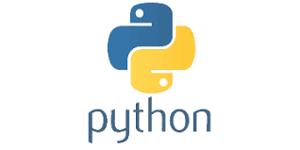
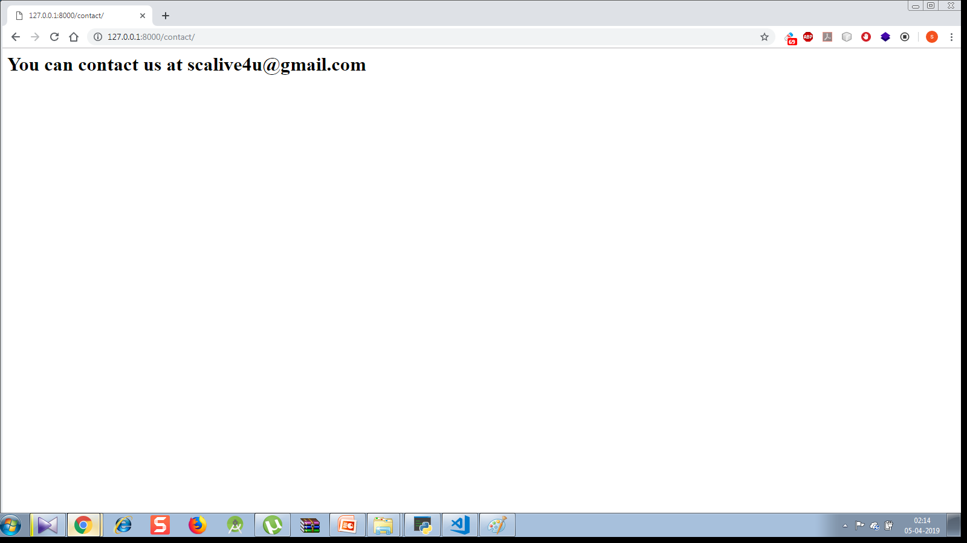
Exercise
Modify the previous app so that if a url arrives as http://127.0.01:8000/contact then the message You can contact us at scalive4u@gmail.com should appear
Output:

Slide 36
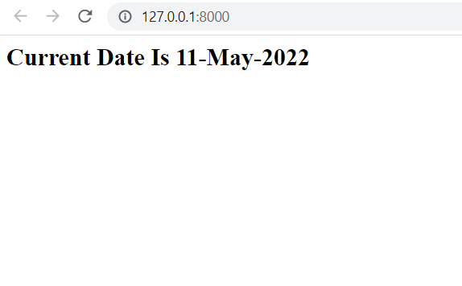
Exercise
Create a Django Project with a Django App which displays current date as the user opens the index page
Output:

Slide 37
How To Obtain Date And Time In Python ?
In Python we have a module called datetime.
This module contains a class called datetime
This class contains a class method called now( ) which returns an object of type datetime containing the current date and time

Slide 38
How To Obtain Date And Time In Python ?
from datetime import *
today=datetime.now()
print(today)
Output:
2022-05-11 10:54:50.683488
As we can see the output contains year, month, day, hour, minute, second, and microsecond.

Slide 39
How To Extract A Particular Part Of Date And Time ?
The previous code displayed date and time details but sometimes we may want only a part of the entire date time.
For example we just want to display the month name or we just want to get the year.

Slide 40
How To Extract A Particular Part Of Date And Time ?
This can be done in 2 ways :
Either by accessing instance fields of the datetime object called year , day , month etc
OR
By using the method strftime() of the datetime object

Slide 41
How To Extract A Particular Part Of Date And Time ?
from datetime import *
today=datetime.now()
print(today.year)
print(today.month)
print(today.day)
Output:
2022
5
11
As we can see the output contains year, month, day separately

Slide 42
How To Extract A Particular Part Of Date And Time ?
For the same task , the class datetime provides us an instance method called strftime( ) .
This method accepts a pattern representing a particular date/time element and returns a string containing that element
Syntax:
<var_name>=<obj>.strftime(“pattern”)

Slide 43
How To Extract A Particular Part Of Date And Time ?
Remember ! These patterns are case sensitive
from datetime import *
today=datetime.now()
day=today.strftime("%d") # this gives day number
month=today.strftime("%b") # this gives 3 letter month name
year=today.strftime("%Y") # this gives 4 digit year
print(day)
print(month)
print(year)
Output:
11
May
2022
We can also club these patterns by passing them as a single string . For ex:
currdate=today.strftime(“%d-%b-%Y”)
will give
16-Aug-2020

Slide 44
List Of Some Common Patterns
Pattern | Meaning | Example
%a | Weekday, short version | Wed
%A | Weekday, full version | Wednesday
%w | Weekday as a number 0-6, 0 is Sunday | 3
%d | Day of month 01-31 | 31
%b | Month name, short version | Dec
%B | Month name, full version | December
%m | Month as a number 01-12 | 12
%y | Year, short version, without century | 18

Slide 45
List Of Some Common Patterns
Pattern | Meaning | Example
%Y | Year, full version | 2018
%H | Hour 00-23 | 17
%I | Hour 00-12 | 05
%p | AM/PM | PM
%M | Minute 00-59 | 41
%S | Second 00-59 | 08
%f | Microsecond 000000-999999 | 548513
%j | Day number of year 001-366 | 365

Slide 46
List Of Some Common Patterns
Pattern | Meaning | Example
%c | Local version of date and time | Mon Dec 31 17:41:00 2018
%x | Local version of date | 12/31/18
%X | Local version of time | 17:41:00

Slide 47
Exercise
Modify the previous App so that it now has 2 pages , one displays current date and the other displays current time. The url for date page should be showdate.html and for time page should be showtime.html

